Slide 1
GLOBAL VARIABLES (available throughout entire file)

Slide 2
"When a 14 year old kid can blow up your business in his spare time, not because he hates you but because he loves you, then you got a problem."
— Clay Shirkey, 2008

Slide 3
Brief Introductions
Name
Hometown
Area of study / interest
Anything specific you expect from this class?

Slide 4
This semester
Reading about the business of news
Discussing strategies and solutions
Brief case studies
Guest visits from alumni for Q & A
Four unit-ending quizzes
Writing a short research paper on ‘the future of news’

Slide 5

Our Textbook

Slide 6
Final Paper
A case study of a news organization that is succeeding
Interviews with news professionals with a specific focus
An analysis of a product like AI in relation to news
A study of themes such as engagement journalism, news product management, civic journalism, etc.
A more academic study of a specific strategy or challenge

Slide 7
Unit Quizzes
Take-home
Questions from the book
Questions from web readings
Questions from key points in class discussion
Mostly multiple choice or short answer
Two 500-word essay answers
Two hours, Open book

Slide 8
Unit Quizzes
Quiz FOUR Week 15 Chapters 9-11

Slide 9
Attendance
Everyone is busy but absences hurt class discussion
Points are to reward consistency

Slide 10
Wednesday Guest Speakers TK
One
Two
Three
Four

Slide 11
Wednesday Guest Speakers
Usually on Zoom - attend from anywhere - but be prepared to ask questions

Slide 12
Wednesday Guest Speakers
Their Mizzou experience
Career path since then
Current jobs
Answer your questions

Slide 13
Grades
Four Quizzes = 50%
Final Report = 30%
Drafts = 10%
Attendance = 5%
Guest Questions = 5%

Slide 14
No class
First column item 1
First column item 2
First column item 3
Second column item 1
Second column item 2
Second column item 3

Slide 15
The class discusses
Journalism
Business
Marketing
Management
Psychology
Economics

Slide 16
Most problems worth solving require us to cross boundaries within the organization, across diverse expertise, different understandings, and sometimes conflicting goals and incentives.

Slide 17
Journalist’s Creed
I believe that the public journal is a public trust; that all connected with it are, to the full measure of their responsibility, trustees for the public; that acceptance of a lesser service than the public service is betrayal of this trust I believe that clear thinking and clear statement, accuracy and fairness are fundamental to good journalism. I believe that advertising, news and editorial columns should alike serve the best interests of readers; that a single standard of helpful truth and cleanness should prevail for all; that the supreme test of good journalism is the measure of its public service.

Slide 18
Digital has knocked down the wall between editorial and business - we need journalists to renegotiate and rebuild those norms.

Slide 19
News needs journalists who…
Understand the business
Understand audience needs
Can uphold editorial values and ethics
Can lead

Slide 20
What is News Product Management?
It can be a job title

Slide 21
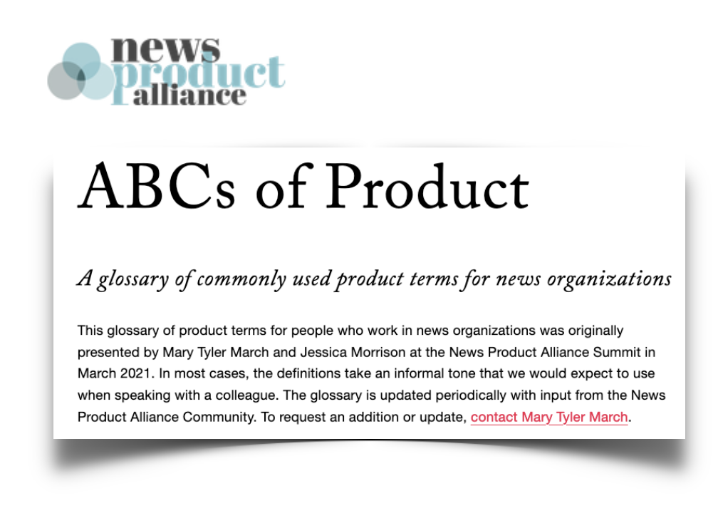
External resources

Slide 22
It asks how journalism can:
Serve our communities better
Build sustainable organizations
Build healthy organizations

Slide 23
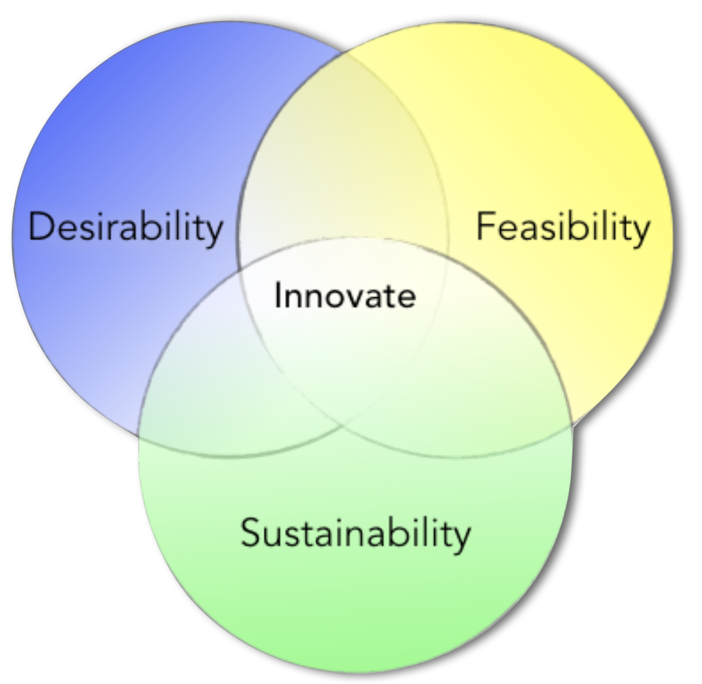
Human-Centered Design

Slide 24
Defining questions
(needs image)

Slide 25
Buile Measure Learn
Needs image

Slide 26
Social and Audience Strategy
Needs two column

Slide 27
Social and Audience Strategy
Students will learn to apply critical thinking at the intersection of journalism, technology and audience needs. You will learn and practice audience engagement tactics on social media platforms and research and develop organizational strategy by understanding how different digital channels: web, app, email, or podcast can be used to support community information needs and support a sustainable business. You will learn methods of news innovation to align organizational and community efforts in support of quality journalism. Relevant job titles: Digital media producer, news product manager, editor, director of audience growth, audience development project manager, social media editor, audience engagement producer, product operations manager, director of product, strategist, UX researcher, analytics & insights editor, head of strategy

Slide 28
The Mission of News
Help a community to understand itself
Inform discussions and decisions that favor a healthy civic life
Enabled by a wall between business and editorial
But, the digital economy knocks down the wall

Slide 29
Information used to be expensive to distribute. Then came the Web. Information used to be expensive to access. Then came mobile. Information used to be expensive to produce. Then came AI.

Slide 30
Jobs to be Done
Make me smarter
Give me something to talk about
Look out for my interests
Entertain me
Guide me
Save me money

Slide 31
That means
Understanding community information needs
Assessing and improving organizational skills and capacity
Strategic design of coverage, products and services for sustainability
Managing the people and processes involved
Reducing risk in decisions
Connecting mission - vision - strategy - tactics

Slide 32
Damon Kiesow

